Slide 1
An Empirical Study of AI Patents
Amy Semet
University of Buffalo School of Law

Slide 2
USPTO AI Database (2020)
Contain one or more of several AI technology components: machine learning, natural language processing, computer vision, speech, knowledge processing, AI hardware, evolutionary computation, and planning and control)
Machine learning (ML) approach that analyzed patent text and citations to identify AI in U.S. patent documents (Abood and Feltenberger 2018; Toole et al. 2020)
  1976-2020 and pre-grant publications (PGPubs) published through 2020
AI model re: whether one of the categories based on text of patent, its claims and its citations (backward and forward)
  12 million patent documents between 1976-2020 (abstract and claims) and backward and forward citations (US granted patents and apps only)
Knowledge processing, and planning and control have lower performance statistics than others
2018: 25% of patents are AI; mostly new entrants
Manual process: 4 examiners hand coded 400 documents each from selected group of about 600 documents
668,808 AI patents within 13 million patents

Slide 3
District Court Database
Originally-constructed database of 56,000 district court decisions involving patents from 2010 to 2020
Code for legal issue, procedural posture, parties, country of parties, technology type, motion disposition, and other values
Merge AI database with district court database to analyze the 19,000+ cases involving AI litigated patents 2010 to present

Slide 4
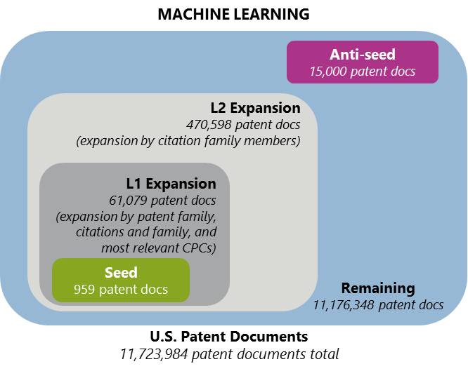
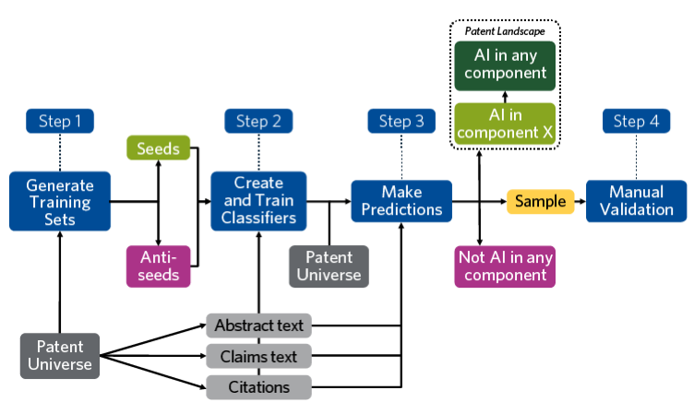
PTO Database: Process
Artificial Intelligence Patent Dataset (AIPD) Page 8 U.S. Patent and Trademark Office August 2021

Slide 5
Time Trends

Slide 6
AI Patents: Overall v. Litigated Patents

Slide 7
AI Patents by Country
25% of all AI litigation is filed by foreign parties
Knowledge, planning, machine learning- foreign
Vision and speech – U.S.

Slide 8
AI Plaintiffs: Comparison
59% of AI patent litigation are filed by “high volume plaintiffs” versus 39% of non-AI litigation.

Slide 9
Procedural Disposition
Summary judgment and procedural dismissal percentages do not differ between AI and non-AI litigated patents. But contested dismissals, consent judgments, and trials are less likely among AI-litigated patents to a statistically significant degree, depending on the technology type.
Half of invalidated AI patents are done through judgment on the pleadings.

Slide 10
Technology Type of Invalidated AI Patents

Slide 11
Substantive Outcomes: Invalidity
More likely to find AI patents invalid overall
  Non-AI patents were invalidated 23% of the time while a stark 62% of AI patents reaching an invalidity decision were invalidated
  Especially on subject matter and definiteness
    Of the cases where the court issued an invalidity ruling, 53% of AI patents are invalidated under section 101, compared to just 10% of non-AI patents (especially prevalent among knowledge, natural language processing and planning patents). Half are resolved through judgment on the pleadings.
    About 18% of AI inventions are invalidated due to lack of definiteness, compared to just 9% of non-AI inventions where validity is reached (primarily planning patents). Most settle or are resolved by summary judgment
  Evolutionary and natural language processing patents are more likely than non-AI patents to be invalidated based on lack of enablement
  No difference for obviousness except for planning where less likely to be obvious
  No difference for anticipation

Slide 12
Substantive Outcomes: Infringement
Less likely to find AI patents infringed
  Of the nearly 7,200 cases where the court reached an infringement decision, 21% involved AI patents compared to 56% of cases involving non-AI patents
  Applies to all categories, especially planning patents (30% infringed)
Infringement is hard to monitor for AI inventions
  AI is often used by multiple parties: developers, trainers, customers, all of whom may be contributing to the ultimate infringement of the product
  Infringement may only take place in an instant
  Jurisdictional issues
  May be difficult to determine whether an AI program has substantial noninfringing uses so as to escape liability for contributory infringement
  Discovery complicated by fact that many AI-intensive firms acquire the technology from another entity in a merger so if requisite licenses and assignments were not executed for the merger, it may make it difficult for parties to comply with discovery obligations in litigation.

Slide 13
Ways Forward
Prosecutors may need to better emphasize how AI improves the functionality of the technology, such as by noting the “increased efficiency, accuracy or performance.”
It may be increasingly important to emphasize how the patent claims operate practically, and in particular, how the AI invention achieves its result in the real world. Making clear these connections is critical to ensuring that the invention is not improperly labeled “abstract” without any inventive concept attached to it.
When training datasets are used, the claims need to be clearer with respect to show how the AI data is trained. Claims should identify the “specific algorithm, models, and techniques used to develop the training data, and how these contribute to solving the technical problem.”
Infringement theories may need to be modified; Since some infringement may only be temporary, the law needs to account for whether transient or temporary infringement should constitute infringement under the patent laws.
Discovery will need to adopt to more third parties involved in the litigation process.

