Slide 1
A Data-Driven Analysis of Bond Decisions in the Immigration Courts Through the Trump Administration
Amy Semet
Associate Professor of Law
University of Buffalo School of Law

Slide 2
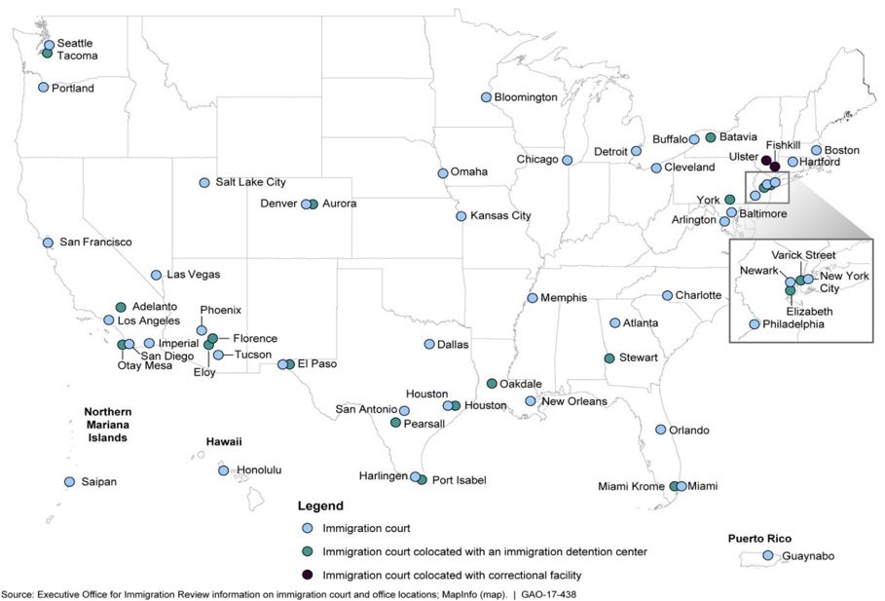

Slide 3
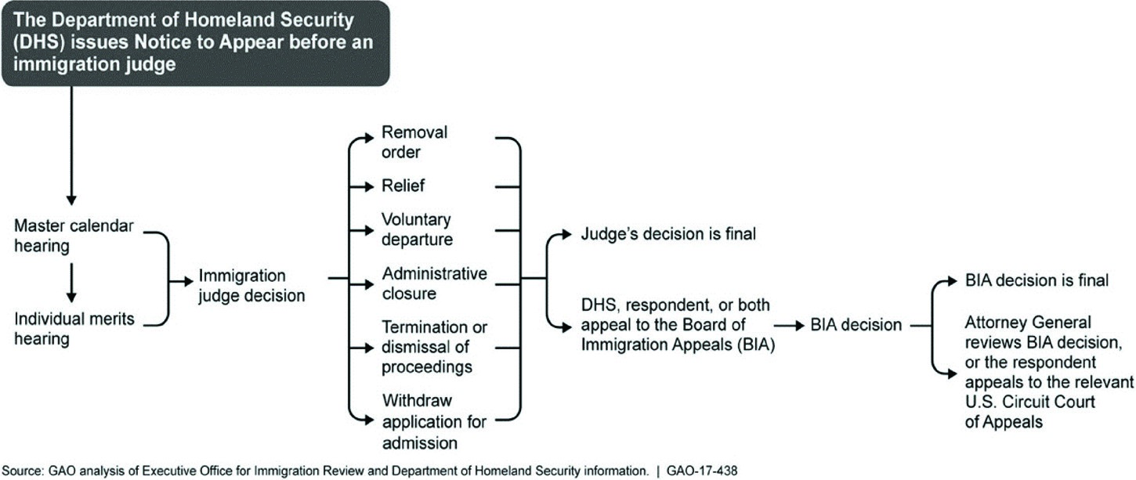

Slide 4
Bond Decision Coding
Bond Decisions
  Own Recognizance
  New Bond Amount
    Lower or Higher than amount set by ICE
  No Change/Action
  No Bond
  No Jurisdiction (mandatory detention, certain asylum, etc.)
Win Rate
  “1” if coded Own Recognizance or new bond amount < initial bond amount
  “0” if coded new bond>initial bond amount or no bond

Slide 5
EOIR Database
Over 1 million bond decisions in removal cases from January 20, 2001 through March 7, 2020 decided by appointed IJs
  First bond case if more than one bond decision
Exclude
  Rider cases
  Any non-removal case involving a bond hearing
  Cases decided by Carter or Nixon appointees or visiting judges not appointed
  IJs who heard less than 50 bond proceedings or decisions by those who had not yet been appointed
  Cases in which custody status listed as “never detained”
  Cases coded as “jurisdictional” (mandatory detention, certain asylum cases)

Slide 6
Win Rates, by Appointee Cohort

Slide 7
No Bond, by Appointee Cohort

Slide 8
Win Rates, by Presidential Era

Slide 9
No Bond, by Presidential Era

Slide 10
Win Rate, by Appointee Cohort & Presidential Era

Slide 11
Bond Amount Percentages, by Presidential Era

Slide 12
High Bond Amounts ($10,000 or More), by Appointee Cohort & Presidential Era

Slide 13
Regression Analysis
Pr(Pro-Non-citizen Vote = 1) = Λ(α₀ + β₁Appointee/Administration₁+β₂Noncitizen₁+ β₃Immigration Judge₁ + β₄Geographic₁ + β₅Political₁+ β₆Other₁ +ℇ)
Non-citizen: Lawyer, Nationality, Not Free Country, English-speaking, Asylum, Lead/Rider, Juvenile, Gender
IJ: Gender, Govt, Tenure
Geographic: Detention Facility, Base City, Urban, Foreign Born, Southern Border, Low Employment Rate, Policy Mood
Political: Congress, Circuit Court, BIA
Other: Time/Year
Missing or Incomplete Data: Family Ties, Job, Length of U.S. residence, Fixed U.S. address, Prior attempts to flee, Manner of entry, Criminal History, Caselaw differences

Slide 16
Other Variables
Legal Representation (+)
Not Free Country (+) (- during Obama and Trump Era)
Asylum (+) (not Trump appointees)
Central America/Mexico (-) (Obama era: Mexico (+))
English (-)
Longer IJ Tenure (-)
IJ home city liberalness (+)
Trump appointees: more liberal policy mood (+), Foreign Born (+), Conservative Circuit Court of hearing location (-)
Notes:
D

Slide 17
Methodological Issues
Alternative model specifications: Multilevel model (base city and judge)/Linear probability model/regression discontinuity design
Rotating/IJs on detail
Incomplete and Inconsistent Data
Missing/Imprecise Data on Key Theoretical Variables
Other variables
Selection Effects
Pandemic
Changes over time particularly for Trump appointees

